Slide 1
Energy-Efficient Neuromorphic Computing
MS Project: Mid-Term Presentation
Khritish Kumar Behera
Roll: 17125, Email: khritish17@iiserb.ac.in
Electrical Engineering and Computer Science [EECS] Dept.
Indian Institute of Science Education and Research [IISER] Bhopal
Advisor: Dr. Kuntal Roy, Email: kuntal@iiserb.ac.in

Slide 2
Content
Introduction to Artificial Neural Network:
Training and Testing Phases
Perceptron, Activation Function
Forward Propagation
Gradient Descent
Backpropagation
MATLAB 7x5 Character Recognition
Neural Network using Spintronics:
Magnetic Anisotropy
Potential Landscape of a magnet
Magnetic Field applied in the Hard and Easy Axis
Multiferroics
Design of Neural Network in Hardware
Experimental
Electromagnet
Magnetic Thermal Annealing
Gaussmeter

Slide 3
Spintronics based devices has inherent advantage over transistor:
Weight, Sum and Threshold function
Non-volatile in nature
Piezoelectric
x₁
x₂
x_{n}
.
.
Majority of the Neuromorphic Computing are done on transistor based devices
In terms of Energy dissipation, Transistor have ohmic loss, while spintronics devices does not have ohmic loss
ReadMTJ
Insulator
Magnetostrictive
Write
Non-Boolean Computing

Slide 4
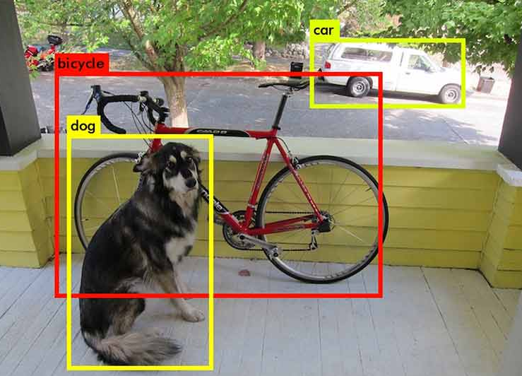

Artificial Neural Network: Motivation
Why Neural Network ?
Rise of Self Driving Car (Tesla)
Object Detection and Object Identification [1]
Face Recognition in Airports
Face detection
Face Recognition [2]

Slide 5
Artificial Neural Network: Training & Testing Phase
Neural Network is a two-phase process
Training Phase
Testing Phase
Training Phase:
The model learns the underlying feature and mapping function of the given input-output data
Testing Phase:
Once the modeled is trained, new input data are feed into the model which were never used in the training phase
Training Data:
( X , T )
X: Input to the model
T: Expected value for input X
Testing is also used for checking whether the model is generalizing the data or its more biased towards the trained data
Input data is feed into the model
The model gives some output form which the error is calculated
Based on the error, the tunning parameter of the model is changed
ERROR: T - O
X
O

Slide 6
Artificial Neural Network: Example
4x4 Character Recognition Model:
Each pixel value (1 or 0) is given to the model as input
The model trains on the training data
Later when test data is given, it gives an accurate result
A
.
.
.
.
.
.

Slide 7
Artificial Neural Network: Perceptron
X1
W1
b
Perceptron is the simplest and most basic form of a neural network
X2
W2
∑
σ
Y
X3
W3
A Simple Perceptron can have more than one input, but the output needs to be just one
Each input edge has a weight associated with it, which can be negative / positive / zero
Each node has a ‘bias’ term associated with it
The Neuron Process through two sequential processes: Summation and Activation

Slide 8
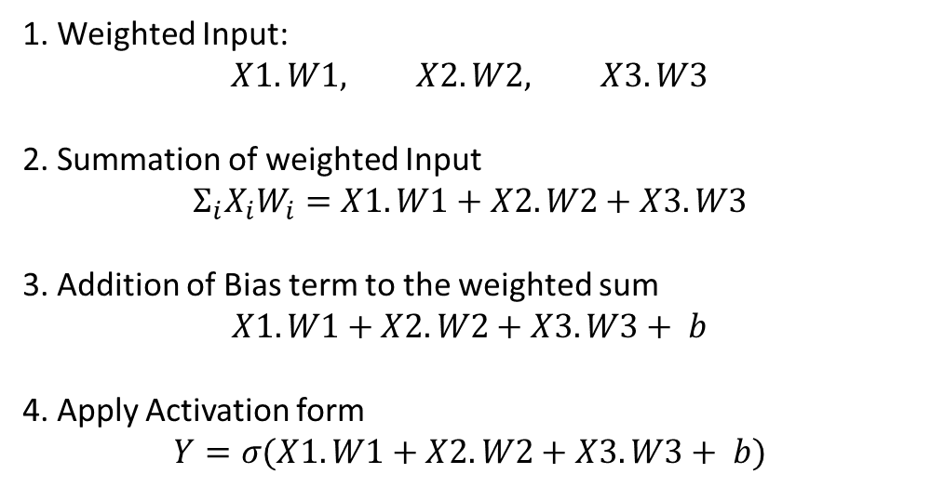
Artificial Neural Network: Perceptron
X1
W1
b
X2
W2
∑
σ
Y
X3
W3
1. Weighted Input:
$$X1.W1, X2.W2, X3.W3$$
2. Summation of weighted Input
$$Σ_{i}X_{i}W_{i}=X1.W1+X2.W2+X3.W3$$
3. Addition of Bias term to the weighted sum
$X1.W1+X2.W2+X3.W3+ b$
4. Apply Activation form
$$Y=σ(X1.W1+X2.W2+X3.W3+ b)$$

Slide 9
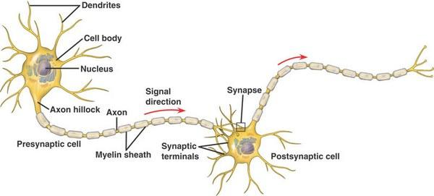
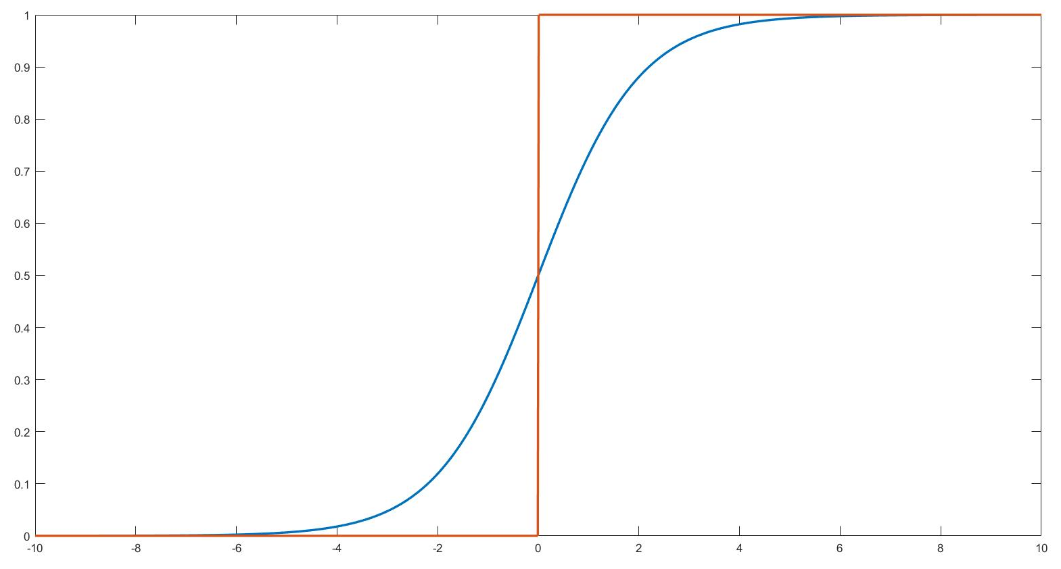
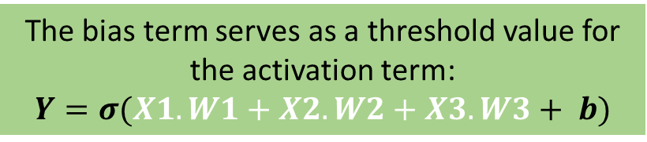
Artificial Neural Network: Activation Function
Activation Function is a non-linear mathematical equation
The bias term serves as a threshold value for the activation term:
$$Y=σ(X1.W1+X2.W2+X3.W3+ b)$$
Activation Function is inspired from biological neuron:
Neurons would not fire and pass the input signal to the next neuron until and unless certain threshold is reached
Bias

Slide 10
Artificial Neural Network: Activation Function
Non-Linearity of Activation Function is the super-power of Artificial Neural Network
Output
Output
Input
Input
The Yellow circle and the red square are linearly classifiable
The Yellow circle and the red square are not linearly classifiable

Slide 11
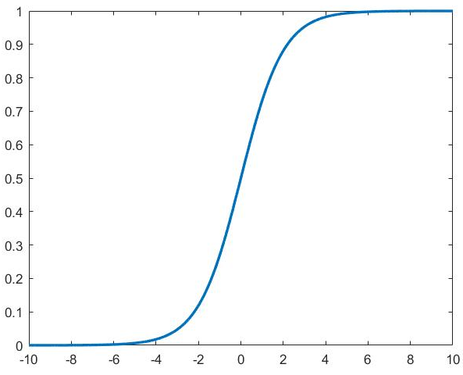
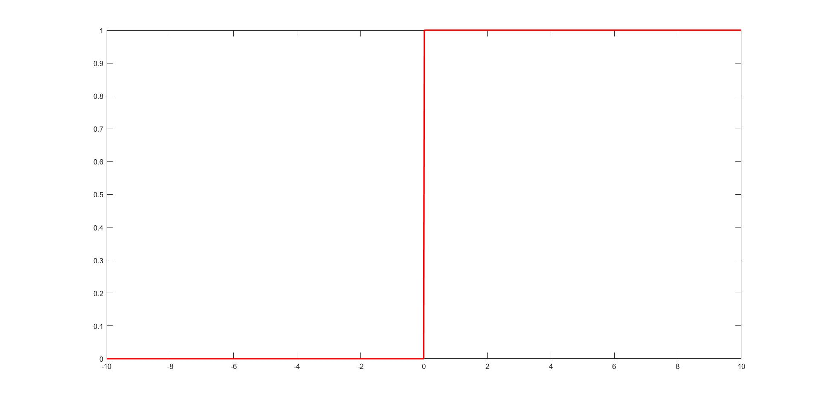
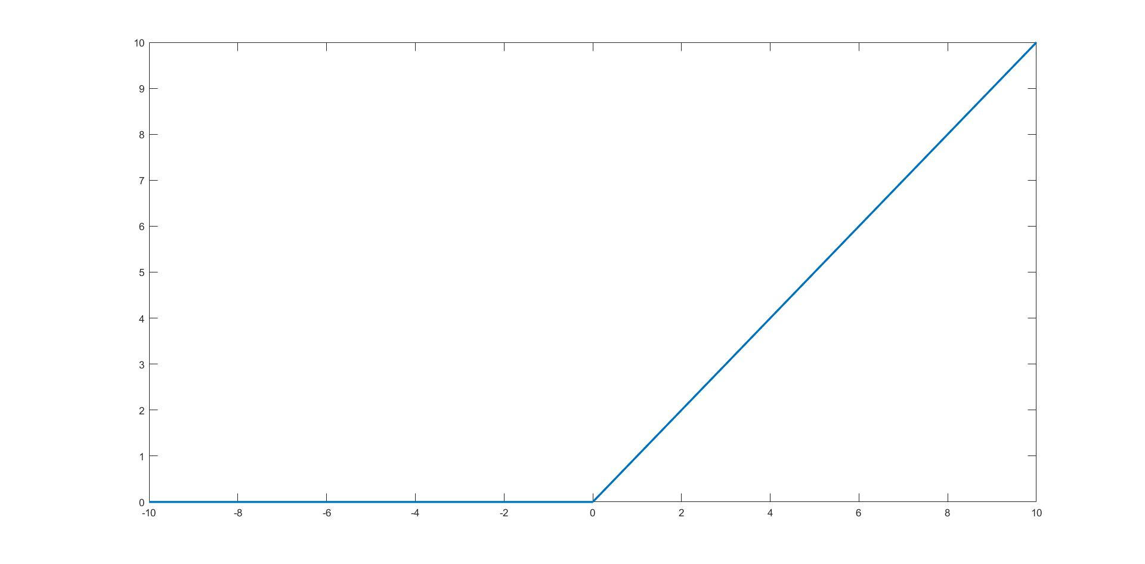
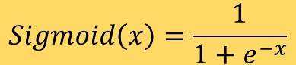
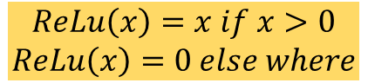
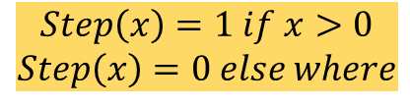
Artificial Neural Network: Activation Function
$$Sigmoid\left(x\right)=\frac{1}{1+e^{−x}}$$
$$Step\left(x\right)=1 if x>0$$
$$Step\left(x\right)=0 else where$$
Rectilinear Unit Function (ReLu)
$$ReLu\left(x\right)=x if x>0$$
$$ReLu\left(x\right)=0 else where$$

Slide 12
Artificial Neural Network: Simple ANN
An Artificial Neural Network is a system of connected artificial neurons
Output of each neuron of one layer is connected to the all of the neurons in the next layer
There are no self loops, no feedback loops
More than one edge emerging out of a neuron, does not mean that there are multiple output of the neuron

Slide 13
Artificial Neural Network: Simple ANN
Input Layer:
Original Input is given here
Neurons simply transfer the input data to next layer without altering the data
No. of neuron depends on the problem requirement
Hidden Layer:
Neurons in the hidden layer alters the input data
At least one hidden layer is required
At least one hidden neuron is required per hidden layer
Hidden Layer:
Neurons in the hidden layer alters the input data
At least one hidden layer is required
At least one hidden neuron is required per hidden layer

Slide 14
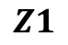
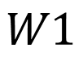
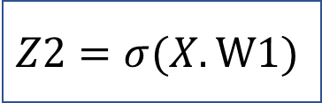
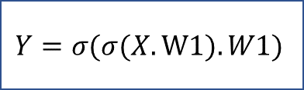
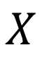
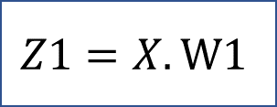
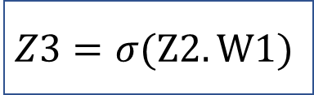
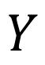
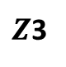
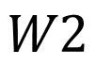
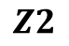
Artificial Neural Network: Forward Propagation
$$W1$$
$$Z1$$
$$Z2$$
$$W2$$
$Z$3
$$X$$
1
2
3
$$Y$$
$$Z1=X.W1$$
$$Z2=σ(X.W1)$$
$$Z3=σ(Z2.W1)$$
$$Y=σ(σ(X.W1).W1)$$

Slide 15
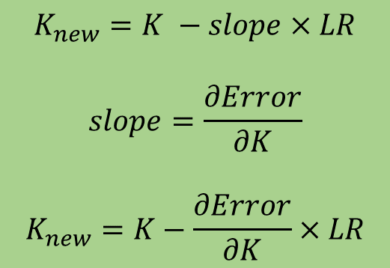
Artificial Neural Network: Gradient Descent
Error
Initial Point
$$K_{new}=K −slope×LR$$
$$slope=\frac{∂Error}{∂K}$$
$$K_{new}=K−\frac{∂Error}{∂K}×LR$$
K (Optimizing Parameter)
LR : Learning Rate

Slide 16
Artificial Neural Network: Gradient Descent
Error
K (Optimizing Parameter)
The Optimizing parameter is always chosen randomly so as to increase the odd of not getting stuck in a local minima
The problem of getting stuck in a local minima is un-avoidable but it can be minimized

Slide 17
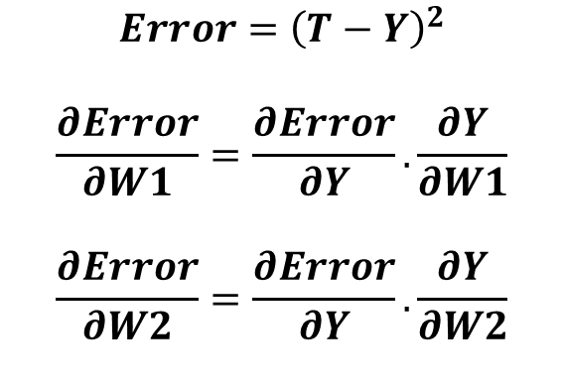
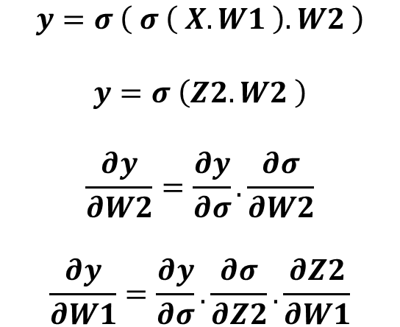
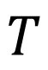
Artificial Neural Network: Backpropagation
$$T$$
Target
$$W1$$
$$Z2$$
$$W2$$
$$X$$
1
2
3
$$Y$$
$$y=σ \left( σ \left( X.W1 \right).W2 \right)$$
$$y=σ \left(Z2.W2 \right)$$
$$\frac{∂y}{∂W2}=\frac{∂y}{∂σ}.\frac{∂σ}{∂W2}$$
$$\frac{∂y}{∂W1}=\frac{∂y}{∂σ}.\frac{∂σ}{∂Z2}.\frac{∂Z2}{∂W1}$$
$$Error={\left(T−Y\right)}^{2}$$
$$\frac{∂Error}{∂W1}=\frac{∂Error}{∂Y}.\frac{∂Y}{∂W1}$$
$$\frac{∂Error}{∂W2}=\frac{∂Error}{∂Y}.\frac{∂Y}{∂W2}$$

Slide 18
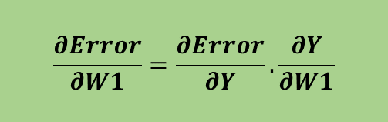

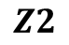

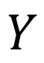
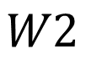
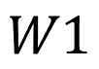
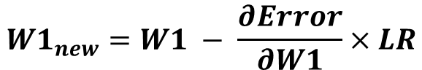
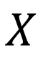
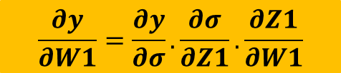
Artificial Neural Network: Backpropagation
$$W1$$
$$Z2$$
$$W2$$
$$X$$
1
2
3
$$Y$$
$$W1$$
$$Z2$$
$$W2$$
$$Y$$
$$X$$
$$σ$$
$$σ$$
Error
$$\frac{∂Error}{∂W1}=\frac{∂Error}{∂Y}.\frac{∂Y}{∂W1}$$
$$\frac{∂y}{∂W1}=\frac{∂y}{∂σ}.\frac{∂σ}{∂Z1}.\frac{∂Z1}{∂W1}$$
$$W1_{new}=W1 − \frac{∂Error}{∂W1}×LR$$

Slide 19
Artificial Neural Network: Character Recognition
We wish to create an ANN which can recognize alphabets from a noisy 7x5 pixel binary pattern
A
A

Slide 20
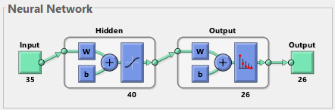
Artificial Neural Network: Character Recognition
Input:
35 Pixel values of the test character
Output:
26 bit array suggesting the character
A: 1,0,0,0,0,0,0,0,…..0,0,0,0
B: 0,1,0,0,0,0,0,0,……0,0,0,0
C: 0,0,1,0,0,0,0,0,……0,0,0,0
Similarly others

Slide 21
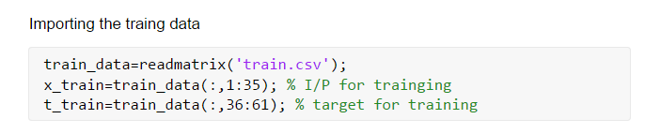
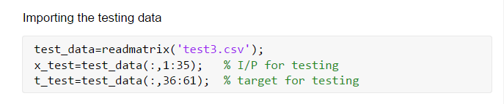
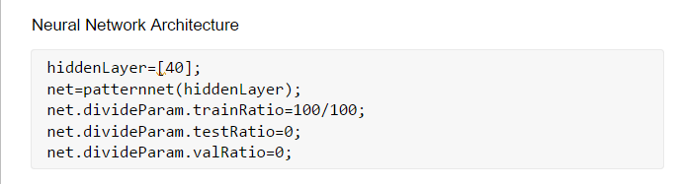
Artificial Neural Network: Character Recognition

Slide 22
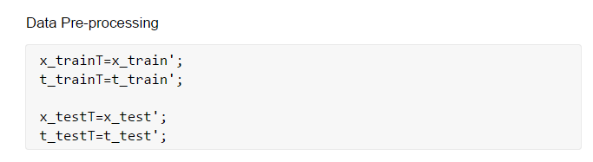
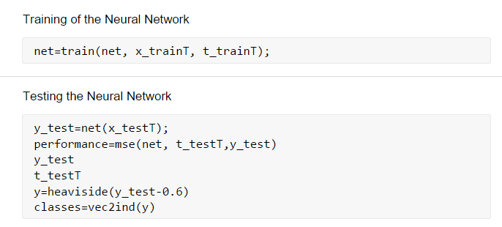
Artificial Neural Network: Character Recognition

Slide 23
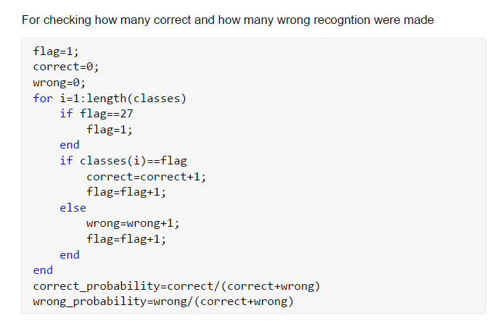
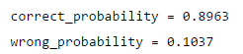
Artificial Neural Network: Character Recognition

Slide 24
Content
Introduction to Artificial Neural Network:
Training and Testing Phases
Perceptron, Activation Function
Forward Propagation
Gradient Descent
Backpropagation
MATLAB 7x5 Character Recognition
Neural Network using Spintronics:
Magnetic Anisotropy
Potential Landscape of a magnet
Magnetic Field applied in the Hard and Easy Axis
Multiferroics
Design of Neural Network in Hardware
Experimental
Electromagnet
Magnetic Thermal Annealing
Gaussmeter

Slide 25
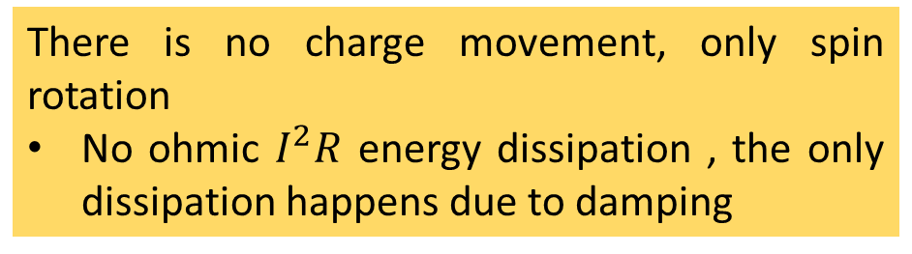
Spintronics: Spin-Electronics
Spin
Spin
Charge
Spin Up (↑) / Down (↓)
0 / 1
Electron
Spintronics device are non-volatile and endurable
Which gives an advantage over transistor, since transistor requires extra circuitry to have the non-volatile nature
Apart from having charge, electron also has a spin
There is no charge movement, only spin rotation
No ohmic $I^{2}R$ energy dissipation , the only dissipation happens due to damping

Slide 26



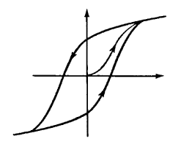
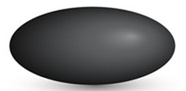
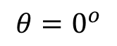
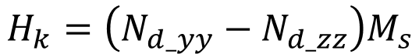
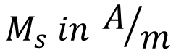
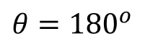
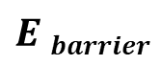





Magnetic Anisotropy
30-80 KT at 300 K
x
In-plane
Shape anisotropy
Magnetization
$$E barrier$$
$$ϕ$$
$$θ$$
z
CoFeB
y
$$φ=±90^{o}$$
$$H_{k}=\left(N_{d_yy}−N_{d_zz}\right)M_{s}$$
$$θ={180}^{o}$$
$$θ=0^{o}$$
$$E_{barrier}=\frac{1}{2}Ωμ_{0}M_{s}H_{k}\sin^{2}{θ}$$
M
Sphere
$$Ω:Volume$$
$$M_{s} in A/m$$
H
H_{k}
Ellipsoid

Slide 27







Potential Landscape of Magnet
$$E_{shape}\left(θ,φ\right)=\frac{1}{2}μ_{0}M_{s}\left[H_{k}+ H_{d}\cos^{2}{φ}\right]Ω\sin^{2}θ$$
$$H_{k}=\left(N_{d_yy}−N_{d_zz}\right)M_{s}$$
$$H_{d}=\left(N_{d_xx}−N_{d_yy}\right)M_{s}$$
$$M_{s}=8×{10}^{5}\frac{A}{m}$$
$$\left(a,b,t\right)=\left(100nm, 90nm, 6nm\right)$$
$$N_{d}=(0.8529, 0.0788, 0.0683)$$
$$θ ( in degree)$$
$$φ ( in degree)$$

Slide 28






Magnetic Field applied on hard axis
$$E=\frac{1}{2}μ_{0}M_{s}H_{k}\sin^{2}{θ−μ_{0}M_{s}H_{y}\sin{θ }}$$
$$\frac{dE}{dθ}=0$$
$$\sin{θmin=\frac{H_{y}}{H_{k}} }$$
$$θmin=\sin^{−1}\left(\frac{H_{y}}{H_{k}}\right)$$

Slide 29




Magnetic Field applied on Easy axis
$$E=\frac{1}{2}μ_{0}M_{s}H_{k}\sin^{2}{θ−μ_{0}M_{s}H_{z}\cos{θ }}$$
$$θ (degree)$$

Slide 30



Multiferroics
P
M
Multiferroic
E
H
Ferroelectric
Multiferroic
and magnetoelectric
Ferromagnetic
E
Piezoelectricity
Magnetoelectricity (intrinsic)
P
P, M
$$ε$$
M
E, H
$$σ$$
H
Magnetostriction
$$\boxed{α_{ME}=μ_{0}\frac{∂M}{∂E}}$$

Slide 31

Design of Neural Network
Neuron
w₁
Neural network
x₁
w₂
y = f(u)
x₂
$$Σ$$
.
.
.
w_{n}
f
x_{n}
Piezoelectric
x₁
x₂
x_{n}
.
.
ReadMTJ
Insulator
Magnetostrictive
Write

Slide 32
Content
Introduction to Artificial Neural Network:
Training and Testing Phases
Perceptron, Activation Function
Forward Propagation
Gradient Descent
Backpropagation
MATLAB 7x5 Character Recognition
Neural Network using Spintronics:
Magnetic Anisotropy
Potential Landscape of a magnet
Magnetic Field applied in the Hard and Easy Axis
Multiferroics
Design of Neural Network in Hardware
Experimental
Electromagnet
Magnetic Thermal Annealing
Gaussmeter

Slide 33
Experimental
Electromagnet for magnetic alignment
Magnetic Thermal Annealing for better magnetic characterization
Gaussmeter for measuring the magnetic field
Sputtering for deposition of different materials, e.g., piezoelectric, magnets
Electron Beam Lithography (EBL) for patterning single-domain nanomagnets
Magnetic Force Microscopy (MFM) for visualizing single-domain nanomagnets
Ferromagnetic Resonance (FMR) for characterizing the magnetic damping parameter
Vibrating Sample Magnetometer (VSM) for magnetic hysteresis

Slide 34

Experimental: Electromagnet
Gauss Probe
Constant Current Power Supply (CCPS)
CCPS : Provides Constant Current to the magnetic coils which in turn generates the magnetic field
Gauss Probe: Is used to measure the magnetic field generated at the pole
Magnetic Coil

Slide 35


Experimental: Magnetic Thermal Annealing
Lattice deformities can degrade material quality
It helps to eliminate structural imperfections
It reorients each spin along applied magnetic field, if the sample has deformed ferromagnetic lattice
Reorientation of the easy axis in a ferromagnetic material

Slide 36


Experimental: Gaussmeter
Gaussmeter is a static electronic magnetic field measurement device
The Gaussmeter has two probes:
Axial Probe: Which measures the magnetic field parallel to the probe
Transversal Probe: Which measures the magnetic field perpendicular to the probe
It measures by the Hall effect, which is the conversion of magnetic field into Hall Voltage
Electrons in magnetic field tries to move in perpendicular direction of applied magnetic field (Lorentz force)

